Slide 1

Investment of the Social and Affordable Housing Sector in Europe
Dara TURNBULL (Research Coordinator)
dara.turnbull@housingeurope.eu

Slide 2
Objectives
The two primary goals of the survey were
To get a sense of the recent investment history of Housing Europe members
To enquire as to the likely future investment of organisations over the medium to long term

Slide 3
Responses – ‘EU-16’
Austria
Belgium
The Czech Republic/Czechia
Denmark
Estonia
Finland
France
Germany
Ireland
Italy
Luxembourg
The Netherlands
Slovenia
Spain
Sweden
United Kingdom (Ex-Northern Ireland)

Slide 4
The Age Profile of the Housing Stock Managed by Housing Europe Members (EU-16)
a high degree of variability, in terms of the age profile of housing units managed, between countries
  63 per cent of units in Slovenia were over 50 years old, versus only 4 per cent in Ireland
  Partly explained by nature of housing provider (HA newer than State/Municipal)
just 24 per cent of units were built in the last 30 years

Slide 5
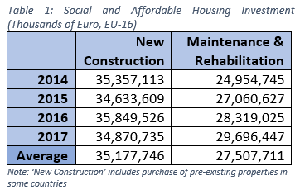
Investment in Construction, Rehabilitation and Maintenance over the past 20 years
The three highest spending countries–France, the UK and Germany–account for around 70 per cent of all investment in new construction
  France accounts for roughly one-third of spending on new construction by itself
The top four spenders–France, the UK, the Netherlands and Germany–account for three-quarters of M&R spending
  Nominal spending has increased in most countries in recent years, as economic conditions improved and housing providers looked more into upgrading the energy rating of their buildings

Slide 6
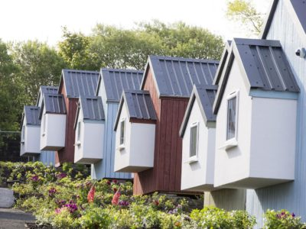
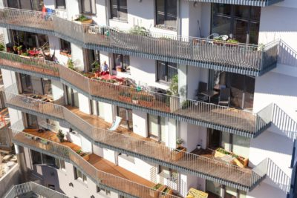
Assessment of Future Building Activity
In the period 2019-2030, respondents to the survey estimate that circa 3.25 million new social and affordable housing units will be delivered
  This equates to around 270,000 units per year
Both aspirational and realistic
The overall cost of delivering the estimated three million plus additional units is €568bn

Slide 7
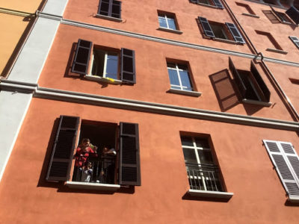
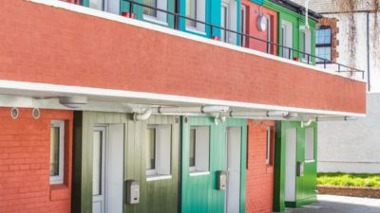
Assessment of Future Rehabilitation Activity
The estimates provided by respondents and Housing Europe show that
380,000 units are expected to be rehabilitated per year on average between 2019 and 2030 This equates to around 4.6 million units in total over the period
  roughly 21 per cent of the nearly 22 million properties owned or managed by respondents at the time of the survey
rough estimate of the investment need approximately €214bn

Slide 8
Assessment of Future Drivers of Investment - Newbuilds

Slide 9
Assessment of Future Drivers of Investment - Rehabilitation

Slide 10
Thank you for your time dara.turnbull@housingeurope.eu

